Slide 1

OPERATING SYSTEMS | LINUX INTER-PROCESS COMMUNICATION
SKYPORT
Ground Operations
Airport Ground Operations Management System Using Linux IPC
End-Semester Project Review | Team of 3
Team members: M Sri Nithya · P Yasasri · G Jahnavi

Slide 2



Introduction & Problem Statement
SKYPORT
Introduction
Problem Statement
SKYPORT simulates airport ground operations
Coordinates multiple incoming flights
Allocates gates, manages waiting queue, processes baggage events, generates announcements
A working simulation, not an actual airport deployment
Many flights compete for a limited number of gates
Gate, baggage and announcement activities run independently
Independent processes must exchange data reliably
Needs a coordinated, multi-process design built on OS-level IPC
SKYPORT – Ground Operations | Linux IPC
2

Slide 3





Objectives & Proposed System
SKYPORT
Proposed System
Objectives
Show how independent processes communicate and coordinate using Linux IPC
Simulate flight arrival, gate allocation, waiting queue, baggage handling and announcements
Display operations on a real-time React dashboard
C Airport Controller
IPC Layer
Central process for gates, queue and events
Unnamed pipes and named FIFOs
Node.js Bridge
React Dashboard
Connects frontend and C system
Live flight and operations view
SKYPORT – Ground Operations | Linux IPC
3

Slide 4






Technology Stack
SKYPORT
C Programming
Ubuntu Linux (WSL)
Unnamed Pipes
Core airport operations and process management
Execution environment
Communication between related processes
Named FIFOs
fork()
Node.js
Communication between independent processes
Creates child processes
Backend bridge between C system and frontend
React.js
HTML & CSS
JSON
Interactive web frontend
User interface and styling
Event communication between backend and frontend
SKYPORT – Ground Operations | Linux IPC
4

Slide 5




System Architecture
SKYPORT
Flight Process
Gate Process
React Frontend
Node.js Bridge
Named FIFO
C Airport Controller
Ground Operation Process
Child processes (fork)
Communication links
Frontend ↔ Node.js
Node.js → C controller
Controller ↔ child processes
C system → dashboard
JSON events
Named FIFO
Unnamed pipes (created with fork)
Events forwarded through Node.js
SKYPORT – Ground Operations | Linux IPC
5

Slide 6
Linux IPC Mechanisms
SKYPORT
What is IPC: Mechanisms that let separate processes exchange data and coordinate.
Why needed here:Flight, gate and ground-operation activities run as independent processes and must share requests and events.
Unnamed Pipes
Named FIFOs
fork()
One-way kernel byte stream
Created with pipe() before fork()
Shared by related (parent–child) processes only
Special file created with mkfifo
Unrelated processes open it by path
Used between Node.js and the C controller
Creates child processes
Children inherit the pipe descriptors
Controller talks to its children through pipes
The C controller is the central coordinator: it receives requests, decides gate or queue, and collects events from its processes.
SKYPORT – Ground Operations | Linux IPC
6

Slide 7
Project Workflow
SKYPORT
1
2
3
4
6
Flight request
(auto or manual)
Request reaches C controller
Gate
available?
Assign gate
Ground service & baggage events
Yes
No
9
Next waiting flight gets gate
5
Flight waits in queue
8
Gate released after service
7
Arrival announcement
then continues from step 4
Events are forwarded through Node.js to the React dashboard at every stage
10
SKYPORT – Ground Operations | Linux IPC
7

Slide 8







Core Features
SKYPORT
Automatic Arrivals
Manual Flight Entry
Gate Allocation
Waiting Queue
C flight process generates requests (AI-502, 6E-214, UK-831, SG-901, IX-442, QP-118); interval configurable
Submitted in React, received by Node.js, forwarded to the C controller
Available gates assigned; occupied gates never reassigned
Used when all gates are full; next flight assigned automatically
Baggage Handling
Announcements
Gate Release
Real-Time Dashboard
Events generated when a flight receives a gate
Arrival announcement events for assigned flights
Gate freed after simulated ground service
React shows flights and updates via the Node.js bridge
SKYPORT – Ground Operations | Linux IPC
8

Slide 9
React Dashboard & Node.js Integration
SKYPORT
React.js Frontend
Dashboard displays flight information and operational updates
Manual flights submitted through the frontend reach Node.js
Node.js forwards requests to the C controller over the IPC bridge
Events from the C system are relayed to React as JSON
Dashboard and flight form
Node.js Bridge
Relays requests and JSON events
Application Views
C Airport Controller
Home Page
Passenger View
System Control Center
Live Flight Dashboard
Gate, queue and event logic
SKYPORT – Ground Operations | Linux IPC
9

Slide 10
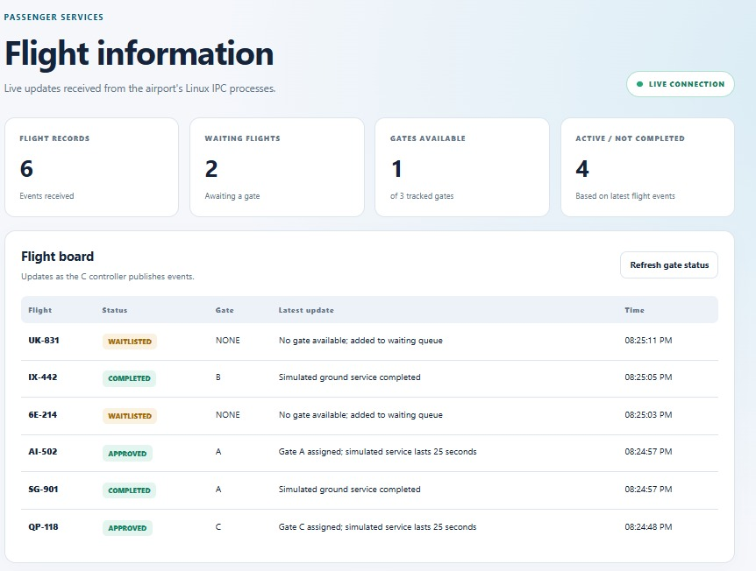
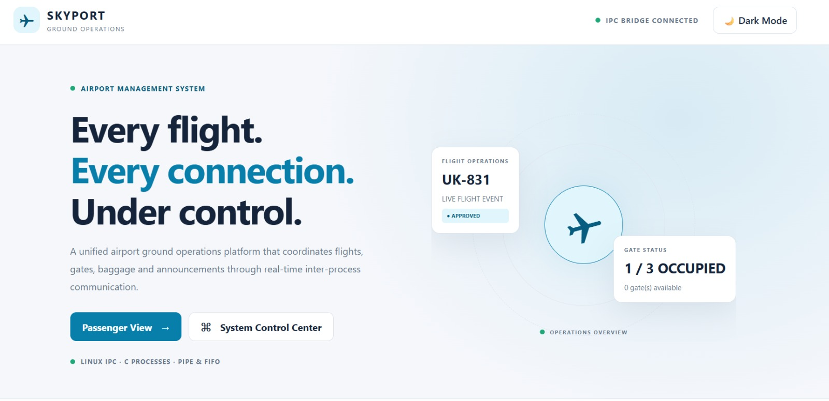
Results & Screenshots – Application UI
SKYPORT
SKYPORT – Ground Operations | Linux IPC
11

Slide 11

Advantages
SKYPORT
Demonstrates practical Linux IPC implementation
Separates operations into independent processes
Supports multiple incoming flight requests
Provides a user-friendly React dashboard
Reduces manual gate allocation effort in the simulation
Integrates C, Linux, Node.js and React
Automatically handles waiting flights
Independent processes, coordinated through IPC
SKYPORT – Ground Operations | Linux IPC
13

Slide 12
Limitations & Future Enhancements
SKYPORT
CURRENT LIMITATIONS
FUTURE – NOT YET IMPLEMENTED
Airport operations are simulated
Ground service completion uses simulated timing
Flight data is not connected to real airline databases
No actual airport hardware is used
Database for persistent flight records
Real-time flight API integration
More advanced gate allocation algorithms
Priority-based emergency flight handling
Live baggage tracking
Authentication for airport administrators
Improved monitoring and analytics
SKYPORT – Ground Operations | Linux IPC
14

Slide 13



Conclusion
SKYPORT shows practical use of Operating Systems concepts, integrated with a Node.js bridge and a React dashboard.
Linux IPC
Process creation (fork)
Synchronization
Communication between independent processes
THANK YOU

